Slide 1


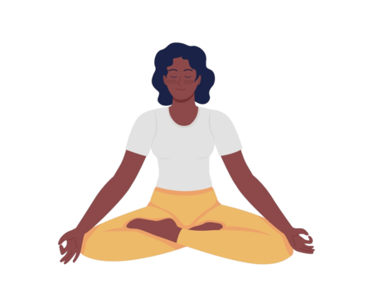
Mindful Conflict Resolution
Harnessing the Power of Mindfulness and Active Listening
Notes:
Now’s the time to relate back to the other trainings. Bring up workplace culture, trust and emotional regulation. They’ll need it to enact the things we are telling them to do in this training.

Slide 2

Agenda
In this session we will explore how to approach conflict with a sense of mindfulness and compassion. With the main topics of focus being:
What causes a conversation to become a conflict
How to stay solution focused
How to actively listen
What an open-ended question is
How to adapt to conflict situations
Ways to practice mindfulness
And when to circle back

Slide 3


Conflict or Conversation
A disagreement can turn into a conflict when emotions become heightened, voices are raised, and personal attacks are made. In a conflict, the parties involved are often focused on winning or proving their point, rather than finding a resolution or compromise. On the other hand, a disagreement can simply be a conversation when both parties are able to express their differing opinions in a respectful and constructive manner.
You never put the delivery away
properly!
STOP BEING LAZY!
I noticed yesterday the milk wasn’t FIFO’d correctly.
Did you need some help?
Notes:
I start this slide off with a question. Have you ever seen a conflict arise out of what should have been a simple conversation? It doesn’t have to be your own conflict this could be something you witnessed, but the whole time you’re thinking to yourself why did something so simple blow up. Could it be that we are so focused on our emotionsinstancen’t see past them. For instance, say you have an employee, and they consistently put the delivery away incorrectly so now you’re at your wits end and you say “you never put the delivery away properly. Your’e so lazy” Did that statement do anything to help the situation?

Slide 4
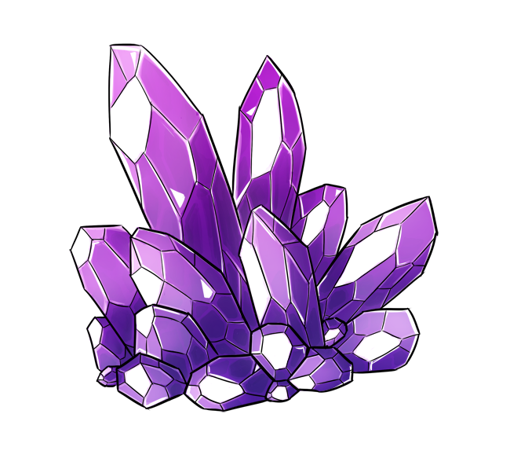


Mindful Gem
What Emotions do you think lead to conflict?
Notes:
1 min. Discuss their answers. If we are stuck in our emotions, it makes it hard to stay solution focused.

Slide 5

Stay Solution Focused
When dealing with workplace conflict, it is crucial to stay solution focused by:
  Gathering information on the conflict
  Understanding the conflicts origins
  Considering each perspective
  Identifying underlying concerns
  Clarifying role, workload
Notes:
By understanding your emotions, you can correct your behavior and instead focus on pinpointing the root of the conflict, only then a clear path to a healthy outcome can be established.

Slide 6
Mindful Gem
Am I Solution Focused?
Notes:
3 mins. 1 min for them to match. Then spend time going over each trait. Relate the negative traits to them. Ask them have you ever been called bossy or defiant then relate those negative traits to the positive traits. Inform them that they can never find the positive outlook if they are not actively listening.

Slide 7
Mindful Gem
bossy
Natural leader, manager and key player
Notes:
3 mins. 1 min for them to match. Then spend time going over each trait. Relate the negative traits to them. Ask them have you ever been called bossy or defiant then relate those negative traits to the positive traits. Inform them that they can never find the positive outlook if they are not actively listening.

Slide 8
Mindful Gem
Holds strong beliefs, bold, unyielding
defiant
Notes:
3 mins. 1 min for them to match. Then spend time going over each trait. Relate the negative traits to them. Ask them have you ever been called bossy or defiant then relate those negative traits to the positive traits. Inform them that they can never find the positive outlook if they are not actively listening.

Slide 9
Mindful Gem
demanding
Knows what they want, outspoken
Notes:
3 mins. 1 min for them to match. Then spend time going over each trait. Relate the negative traits to them. Ask them have you ever been called bossy or defiant then relate those negative traits to the positive traits. Inform them that they can never find the positive outlook if they are not actively listening.

Slide 10
Mindful Gem
dramatic
Expressive, passionate
Notes:
3 mins. 1 min for them to match. Then spend time going over each trait. Relate the negative traits to them. Ask them have you ever been called bossy or defiant then relate those negative traits to the positive traits. Inform them that they can never find the positive outlook if they are not actively listening.

Slide 11
Mindful Gem
fussy
Strong communicator, has strong preferences
Notes:
3 mins. 1 min for them to match. Then spend time going over each trait. Relate the negative traits to them. Ask them have you ever been called bossy or defiant then relate those negative traits to the positive traits. Inform them that they can never find the positive outlook if they are not actively listening.

Slide 12
Mindful Gem
inflexible
Prefers order and predictability
Notes:
3 mins. 1 min for them to match. Then spend time going over each trait. Relate the negative traits to them. Ask them have you ever been called bossy or defiant then relate those negative traits to the positive traits. Inform them that they can never find the positive outlook if they are not actively listening.

Slide 13
Mindful Gem
unfocused
Multitasks, pays attention to many details
Notes:
3 mins. 1 min for them to match. Then spend time going over each trait. Relate the negative traits to them. Ask them have you ever been called bossy or defiant then relate those negative traits to the positive traits. Inform them that they can never find the positive outlook if they are not actively listening.

Slide 14
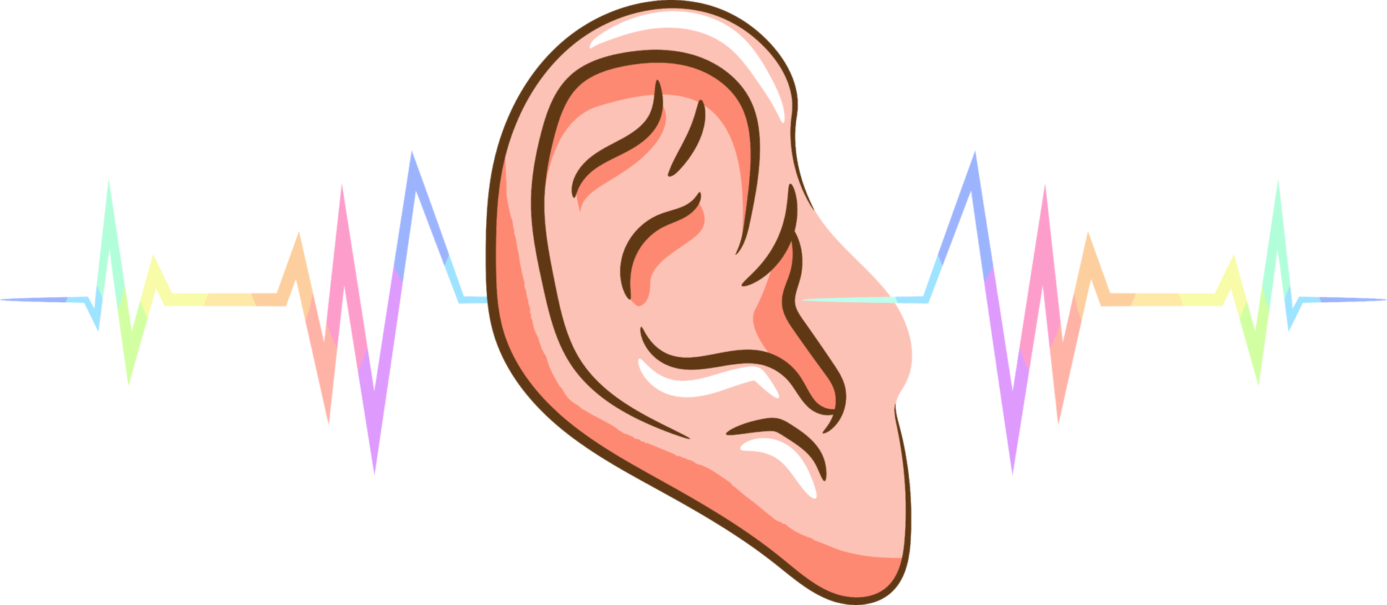
Actively Listen
Active listening is a communication skill that involves going beyond simply hearing the words that another person speaks. Some ways to practice active listening would include:
Be fully present in the conversation
Show interest by practicing good eye contact
Notice and use non-verbal cues
Ask open-ended questions to encourage further responses
Paraphrase and reflect back what has been said
Notes:
It's about actively processing and seeking to understand the meaning and intent behind them. It requires being a mindful and focused participant in the communication process

Slide 15

Open-ended
Questions
Open-ended questions kick off with words like “Why?”, “How?”, “When?” and “What?”. Unlike the yes-or-no kind, they invite a fuller response. It’s not about getting quick answers, but about making the respondent think more deeply about their answers. By using open-ended questions, they invite deeper thoughts, opening doors to honest conversations.
Notes:
Open ended question open the dialogue for more information. Yes and no answers give no real explanation to what the conflict may be and the reasons for the conflict.

Slide 16
Mindful Gems
Do you know how to enter meal count numbers in CMS?
Stop talking to people so rudely!
Do you like sandwiches?
Let’s Talk Open Ended Questions
Notes:
3 mins
Focus on questions that do not reveal a yes or no answer. The questions should require the answer to be extensive. Instead of saying “stop being rude!” focus on what could be the root of the problem. “I noticed you seem flustered. What is bothering you?” this allows you to understand where the behavior might be coming from making it easier to solve the problem.

Slide 17


Adaptation
The art of adapting involves understanding and responding to the emotional tone and atmosphere of the interaction. By adhering to the old saying of
individuals can gauge the dynamics of the conversation and adjust their approach accordingly. Practicing mindfulness, active listening, and engaging in solution-focused conversations can enhance one's ability to adapt to the climate of a conversation.
"read the room”
Notes:
This skill not only promotes better understanding and connection with others but also fosters a more positive and productive exchange of ideas and perspectives

Slide 18

Practice Mindfulness
  It is important to keep a calm demeanor when dealing with conflict resolution. A great calming exercise would be the 4-7-8 breathing exercise. Inhale and exhale slowly, taking care to notice how each breath causes your body to move. Try to be mindful of the sensations as each breath fills your body and pushes out:
        Inhale deeply while counting to four.
        Hold your breath for seven seconds.
        Exhale slowly to eight counts
Notes:
Being calm makes it easier to stay mindful and solution focused. We do our best work with a clear mind. Emotional regulation in important to stay calm because being calm does not mean that you ignore your emotions. You can be angry and calm, even frustrated and calm.

Slide 19
Mindful Gem
Can you think of when and where you may use this technique?
Notes:
3 mins

Slide 20
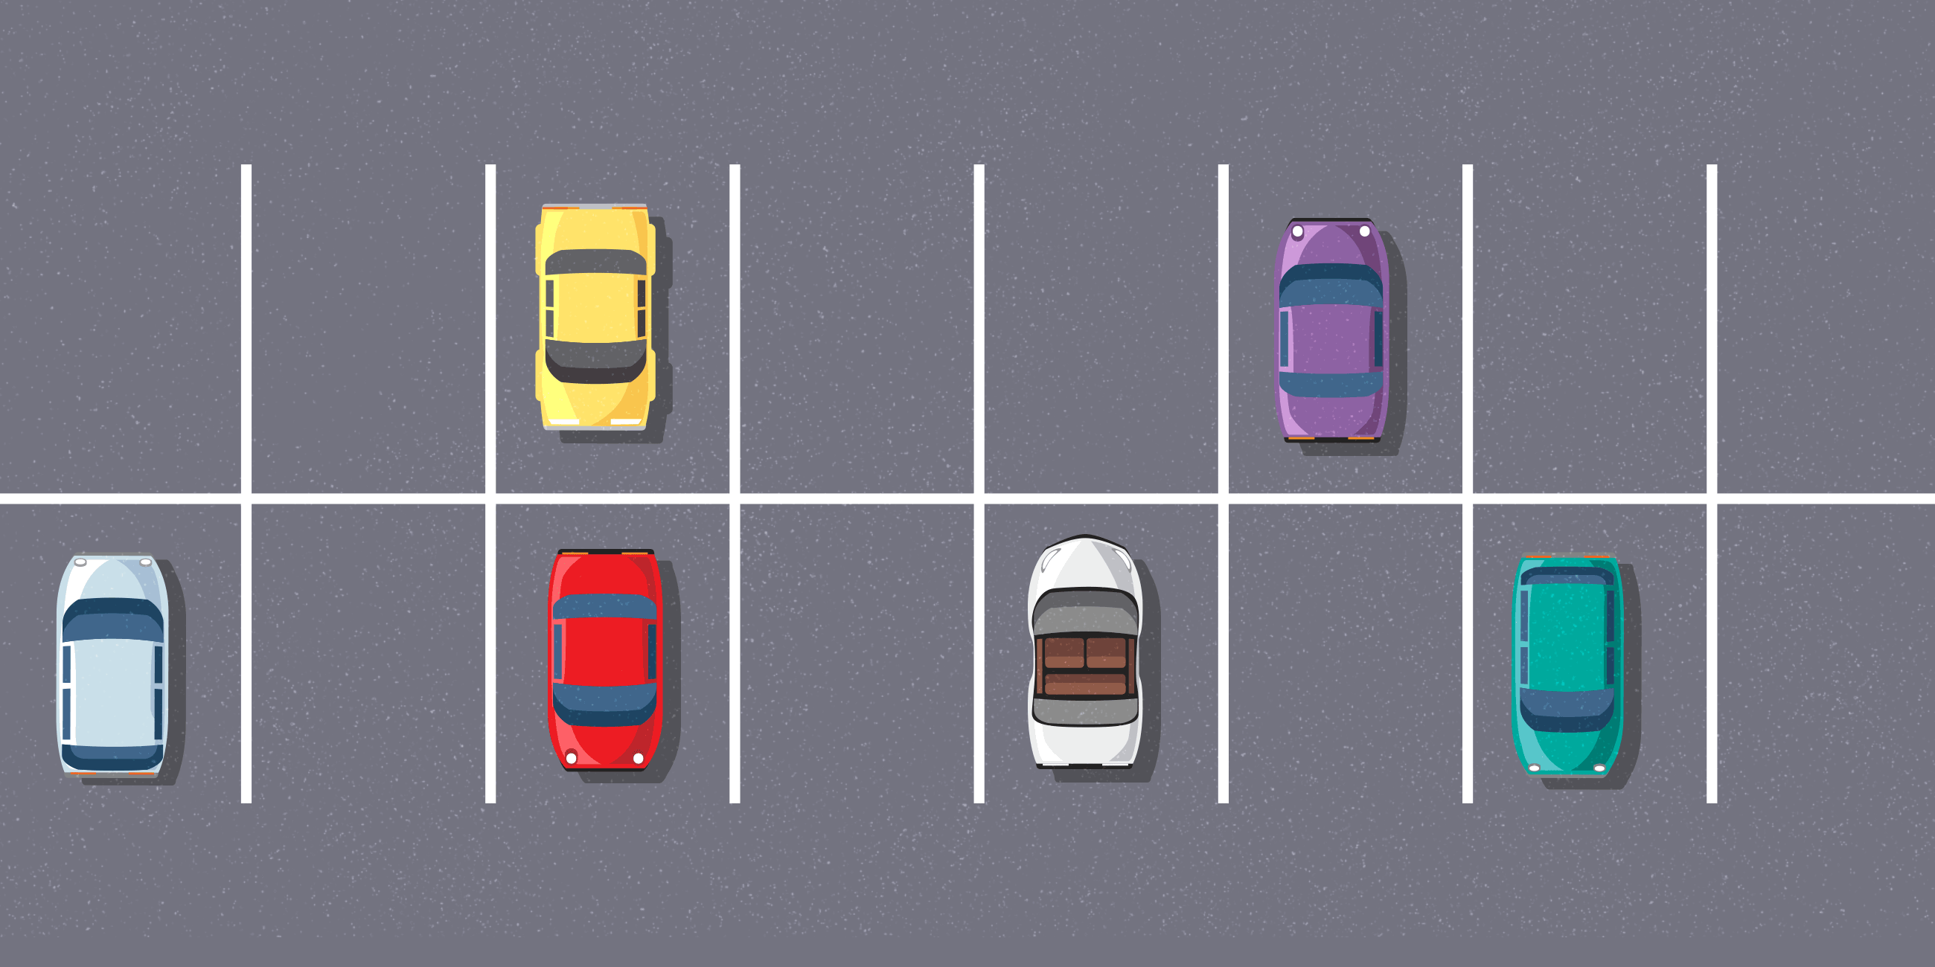

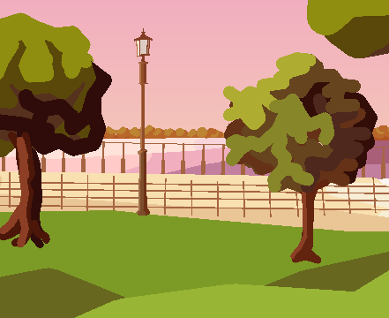
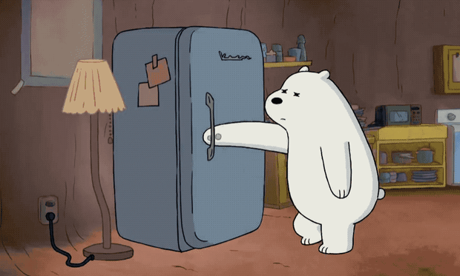
Where to Breathe
Parking Lot
Office
Outside
Freezer
Notes:
Freezer…cold

Slide 21
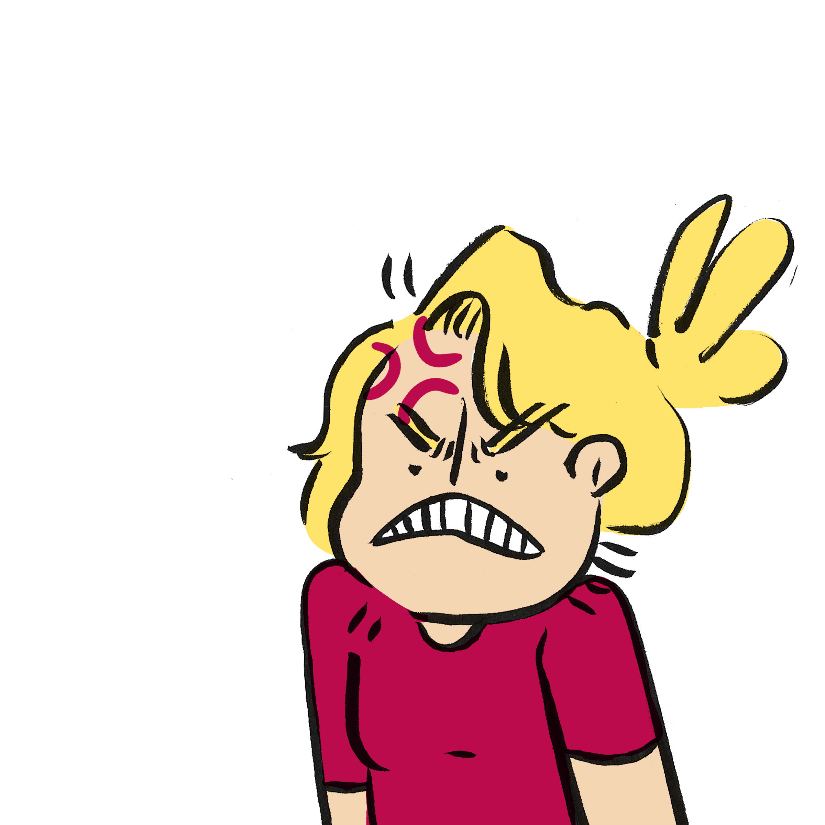
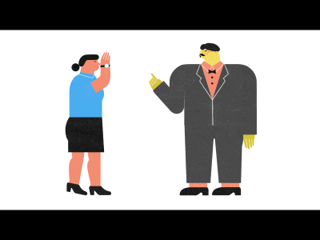
When to Breathe
Heightened emotions
Dealing with conflict

Slide 22
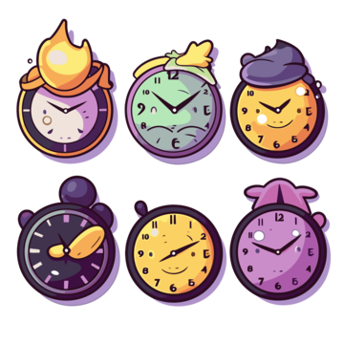
Circle Back
More often than not conversations based in conflict resolution will need to be revisited. Whether a break is needed in the conversation for all parties to reground or to ensure that the solutions presented are working to resolve the conflict. We call this action of revisiting the conversation “circling back.”
  Circling back is the time to:
  provide feedback
  adjust resolution thought processes and plans
  continue a hard conversation
Notes:
It provides time in between the conversation to apply growth and self reflection. Both needed to ensure a conflict is truly resolved.

Slide 23
Mindful Gem
Circle the actions that would be circle back moments.
Notes:
3 mins

Slide 24
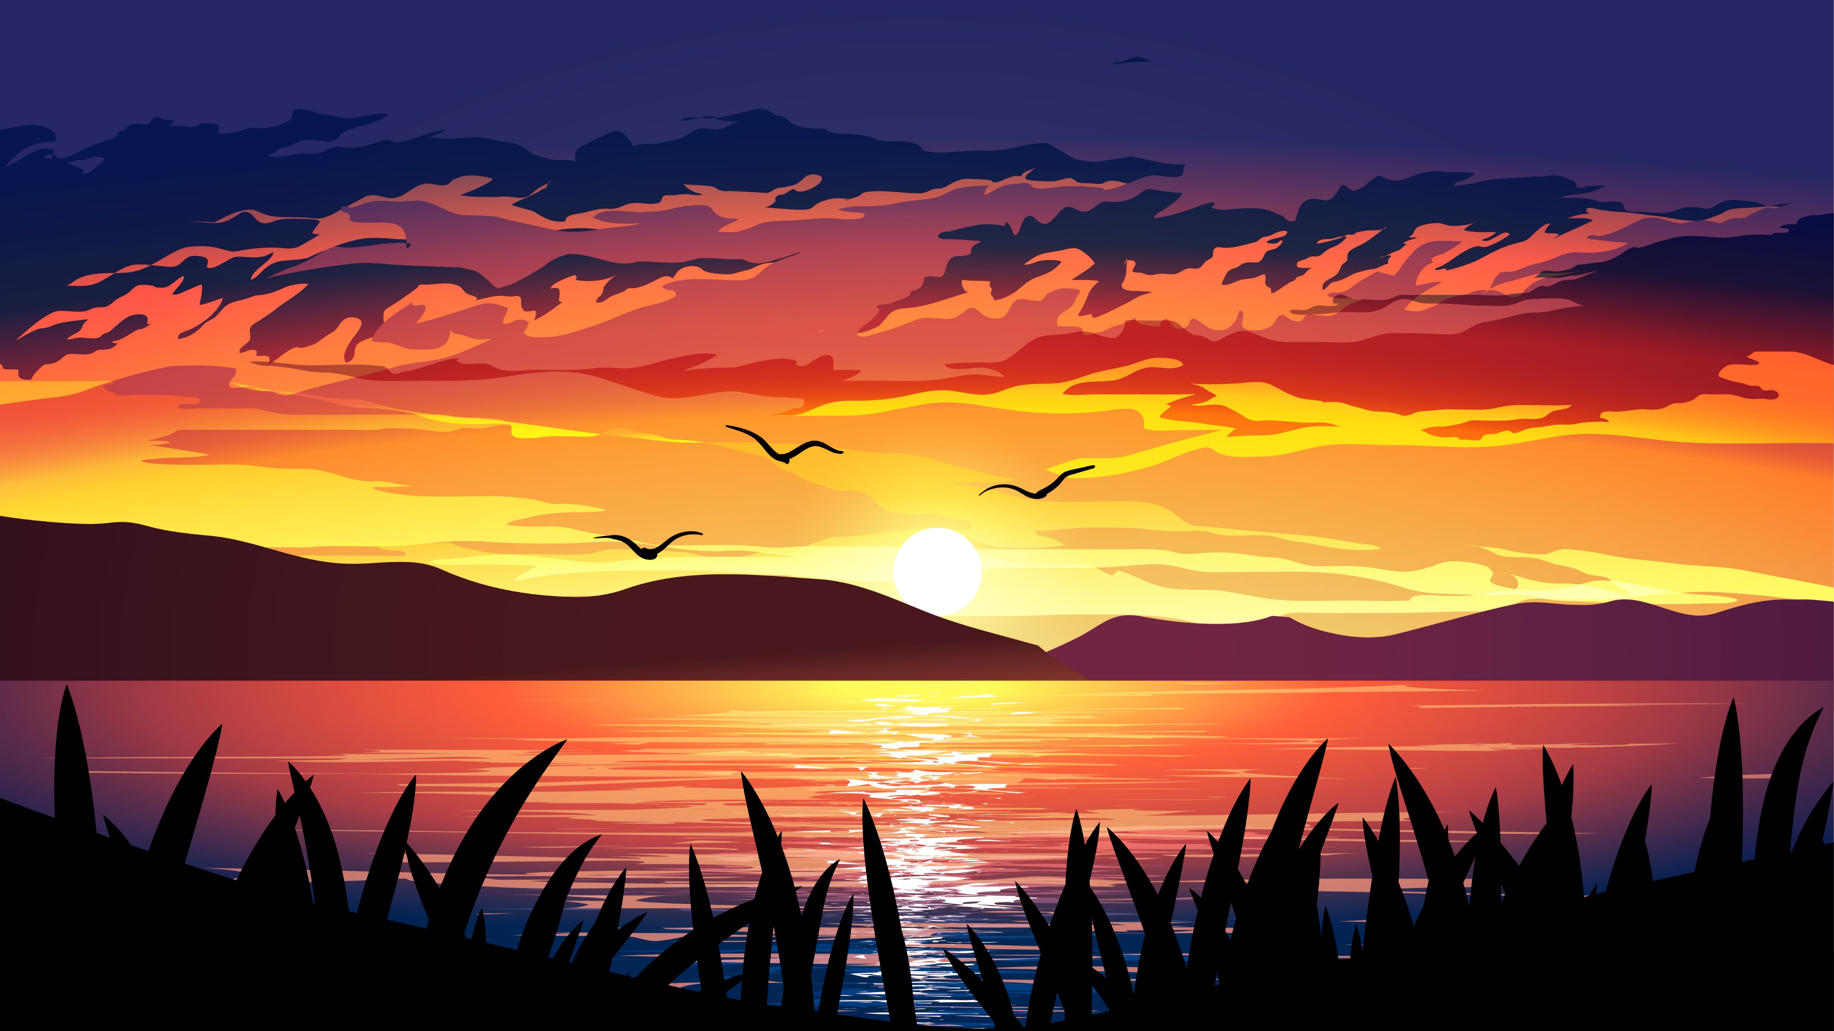
Peace is not the absence of conflict, but the ability to cope with it.
– Mahatma Gandhi

Slide 25
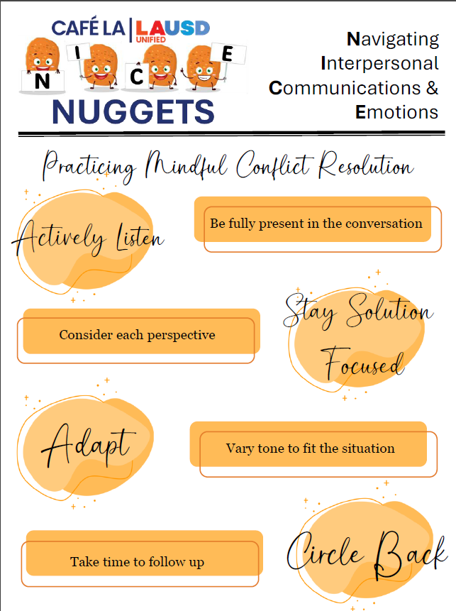

Share and read aloud the “NICE NUGGETS” poster with your staff.
Post it in a visible area for your staff to review as they please.

Slide 26
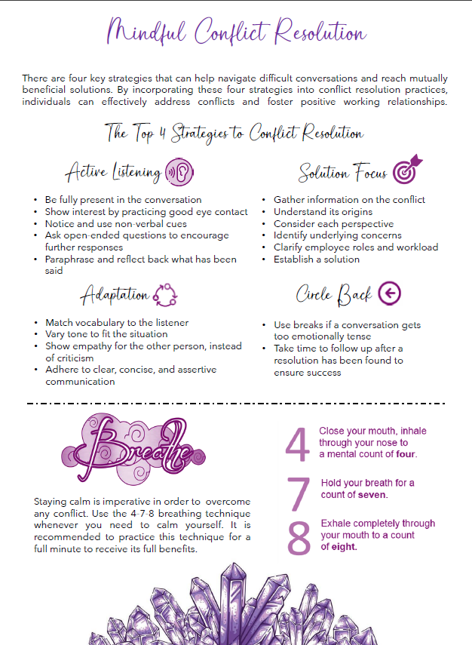
Please enjoy the summary handout and retain throughout the NICE Workshop Program in your 3-ring binder!

